Slide 1
Cryptography and Network Security
Third Edition
by William Stallings
Lecture slides by Lawrie Brown

Slide 2
Chapter 20 – Firewalls
The function of a strong position is to make the forces holding it practically unassailable
—On War, Carl Von Clausewitz

Slide 3
Introduction
seen evolution of information systems
now everyone want to be on the Internet
and to interconnect networks
has persistent security concerns
  can’t easily secure every system in org
need "harm minimisation"
a Firewall usually part of this

Slide 4
What is a Firewall?
a choke point of control and monitoring
interconnects networks with differing trust
imposes restrictions on network services
  only authorized traffic is allowed
auditing and controlling access
  can implement alarms for abnormal behavior
is itself immune to penetration
provides perimeter defence

Slide 5
Firewall Limitations
cannot protect from attacks bypassing it
  eg sneaker net, utility modems, trusted organisations, trusted services (eg SSL/SSH)
cannot protect against internal threats
  eg disgruntled employee
cannot protect against transfer of all virus infected programs or files
  because of huge range of O/S & file types

Slide 6
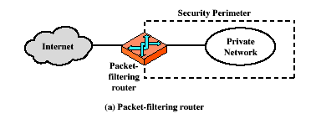
Firewalls – Packet Filters

Slide 7
Firewalls – Packet Filters
simplest of components
foundation of any firewall system
examine each IP packet (no context) and permit or deny according to rules
hence restrict access to services (ports)
possible default policies
  that not expressly permitted is prohibited
  that not expressly prohibited is permitted

Slide 8
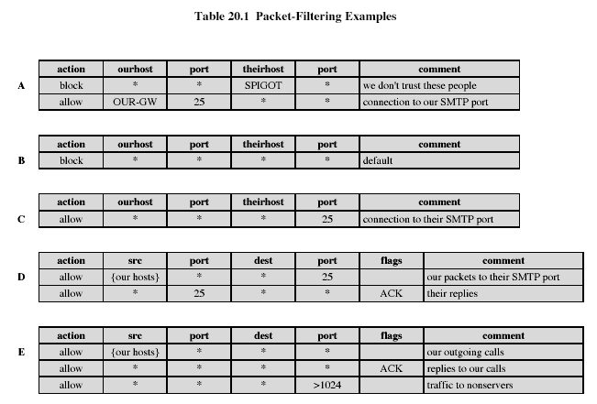
Firewalls – Packet Filters
Notes:
Stallings Table 20-1.

Slide 9
Attacks on Packet Filters
IP address spoofing
  fake source address to be trusted
  add filters on router to block
source routing attacks
  attacker sets a route other than default
  block source routed packets
tiny fragment attacks
  split header info over several tiny packets
  either discard or reassemble before check

Slide 10
Firewalls – Stateful Packet Filters
examine each IP packet in context
  keeps tracks of client-server sessions
  checks each packet validly belongs to one
better able to detect bogus packets out of context

Slide 11
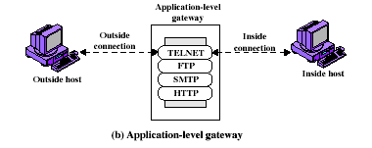
Firewalls - Application Level Gateway (or Proxy)

Slide 12
Firewalls - Application Level Gateway (or Proxy)
use an application specific gateway / proxy
has full access to protocol
  user requests service from proxy
  proxy validates request as legal
  then actions request and returns result to user
need separate proxies for each service
  some services naturally support proxying
  others are more problematic
  custom services generally not supported

Slide 13
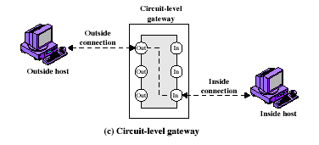
Firewalls - Circuit Level Gateway

Slide 14
Firewalls - Circuit Level Gateway
relays two TCP connections
imposes security by limiting which such connections are allowed
once created usually relays traffic without examining contents
typically used when trust internal users by allowing general outbound connections
SOCKS commonly used for this

Slide 15
Bastion Host
highly secure host system
potentially exposed to "hostile" elements
hence is secured to withstand this
may support 2 or more net connections
may be trusted to enforce trusted separation between network connections
runs circuit / application level gateways
or provides externally accessible services

Slide 16
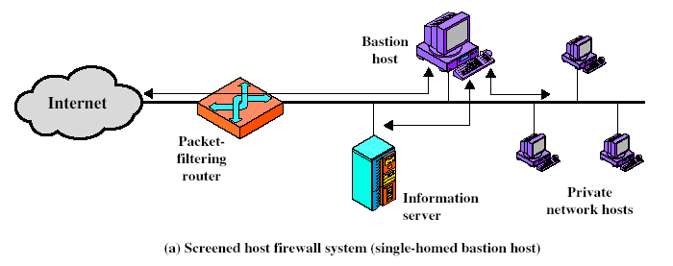
Firewall Configurations
Notes:
Stallings Fig 20-2.

Slide 17
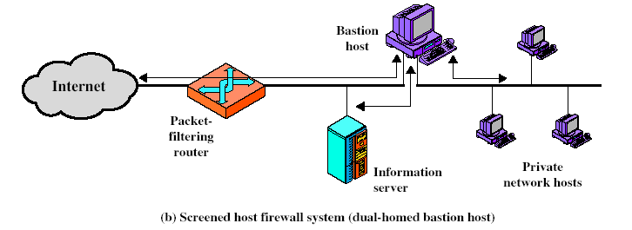
Firewall Configurations
Notes:
Stallings Fig 20-2.

Slide 18
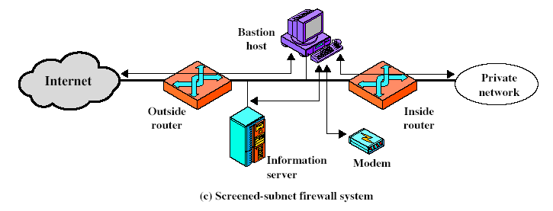
Firewall Configurations
Notes:
Stallings Fig 20-2.

Slide 19
Access Control
given system has identified a user
determine what resources they can access
general model is that of access matrix with
  subject - active entity (user, process)
  object - passive entity (file or resource)
  access right – way object can be accessed
can decompose by
  columns as access control lists
  rows as capability tickets

Slide 20
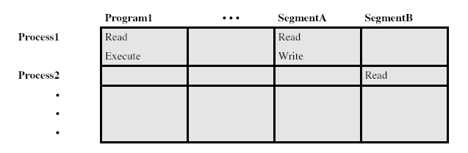
Access Control Matrix
Notes:
Stallings Fig 20-3.

Slide 21
Trusted Computer Systems
information security is increasingly important
have varying degrees of sensitivity of information
  cf military info classifications: confidential, secret etc
subjects (people or programs) have varying rights of access to objects (information)
want to consider ways of increasing confidence in systems to enforce these rights
known as multilevel security
  subjects have maximum & current security level
  objects have a fixed security level classification

Slide 22
Bell LaPadula (BLP) Model
one of the most famous security models
implemented as mandatory policies on system
has two key policies:
no read up (simple security property)
  a subject can only read/write an object if the current security level of the subject dominates (>=) the classification of the object
no write down (*-property)
  a subject can only append/write to an object if the current security level of the subject is dominated by (<=) the classification of the object

Slide 23
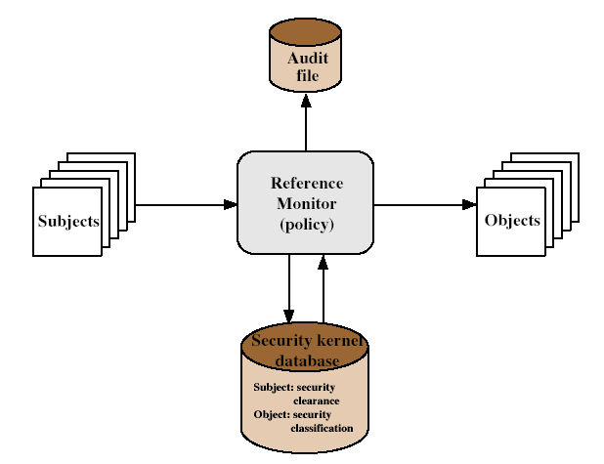
Reference Monitor
Notes:
Stallings Fig 20-4.
Controlling element which enforces the security policies.

Slide 24
Evaluated Computer Systems
governments can evaluate IT systems
against a range of standards:
  TCSEC, IPSEC and now Common Criteria
define a number of “levels” of evaluation with increasingly stringent checking
have published lists of evaluated products
  though aimed at government/defense use
  can be useful in industry also

Slide 25
Summary
have considered:
  firewalls
  types of firewalls
  configurations
  access control
  trusted systems

